Slide 1

King County Housing Data EDA
Neuefische hh-ds-2024-7

Slide 2

Client Jennifer Montgomery
High budget
Within a month
Self-promoter

Slide 3
Your Home Preferences
Waterfront properties
High–graded houses
Renovated homes
Resell potential (within a year)

Slide 4
Research and Hypotheses
Geography
H1: Certain areas have higher prices
Grading of the house
H2: Houses with higher grades are more expensive
Amenities of the house
H3: Grading of the house and waterfront affect prices

Slide 5
Process
Data preparation
  Checking for duplicates
  Changed data types
  Coherently changed the data
Prices depend on…
  Geographical location (long & lat)
  Quality (Grade & (Condition))
  Special amenities (Waterfront)

Slide 6
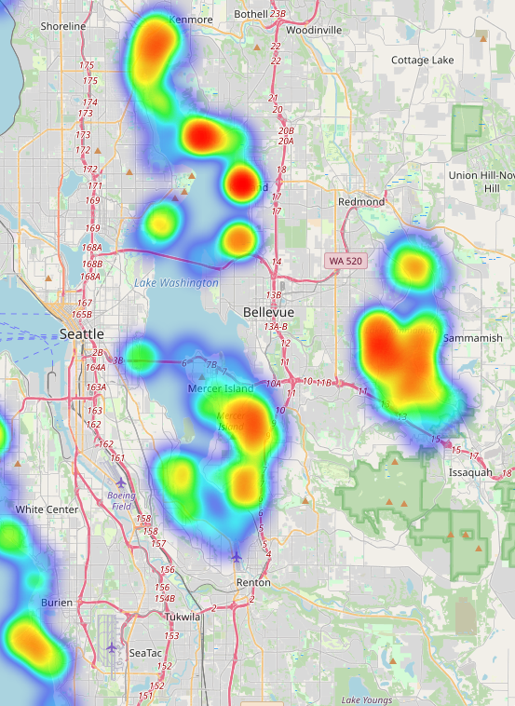
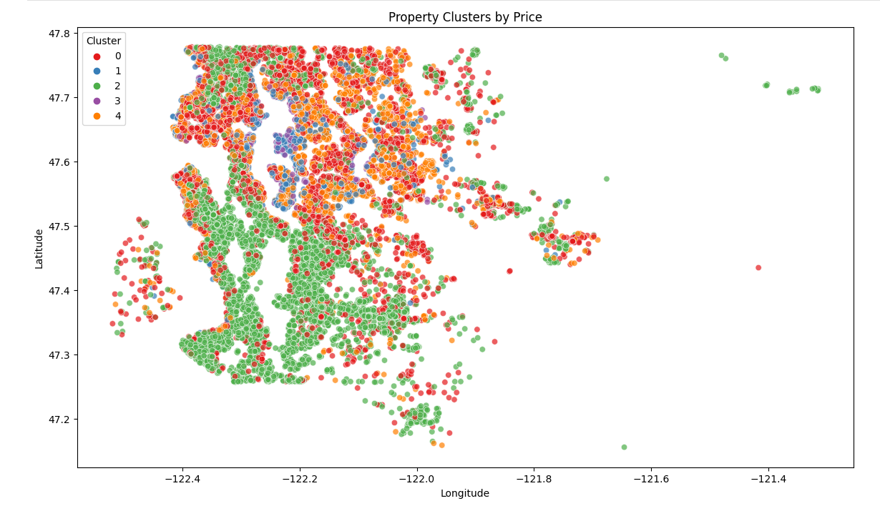
Geographics
H1: Geo areas specify prices

Slide 7
Geographics
H1: Geo areas specify prices

Slide 8
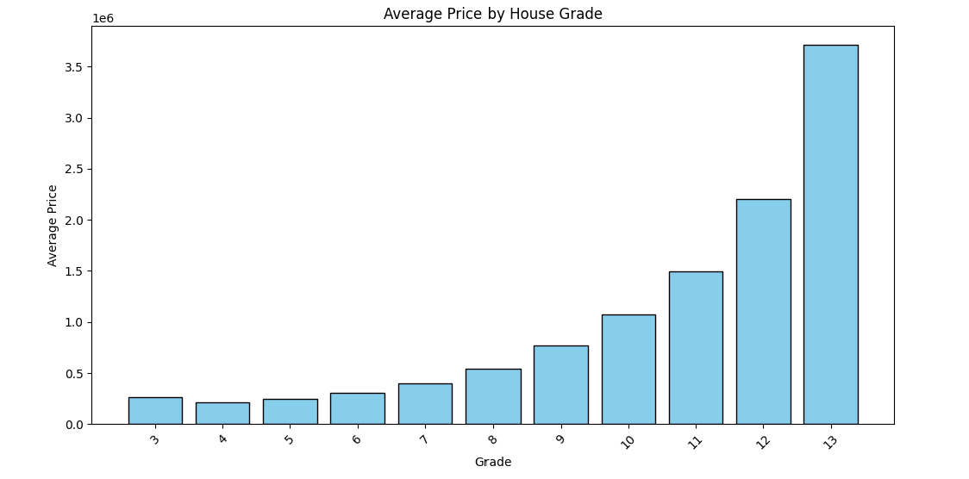
Price by Grade
H2: Grading influences Prices.
1-3: Building construction
7: average level of construction/design
11-13: high quality level of construction & design

Slide 9

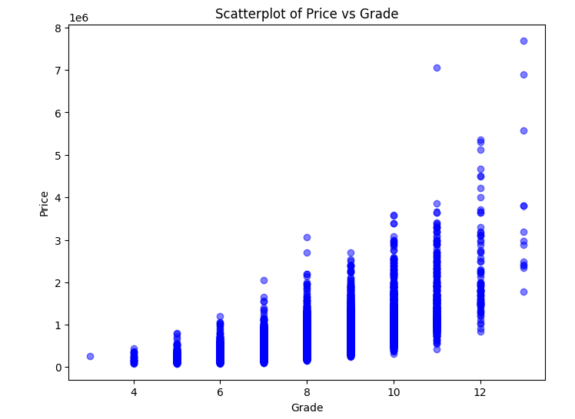
Price by Grade
H2: Grading influences Prices.

Slide 10
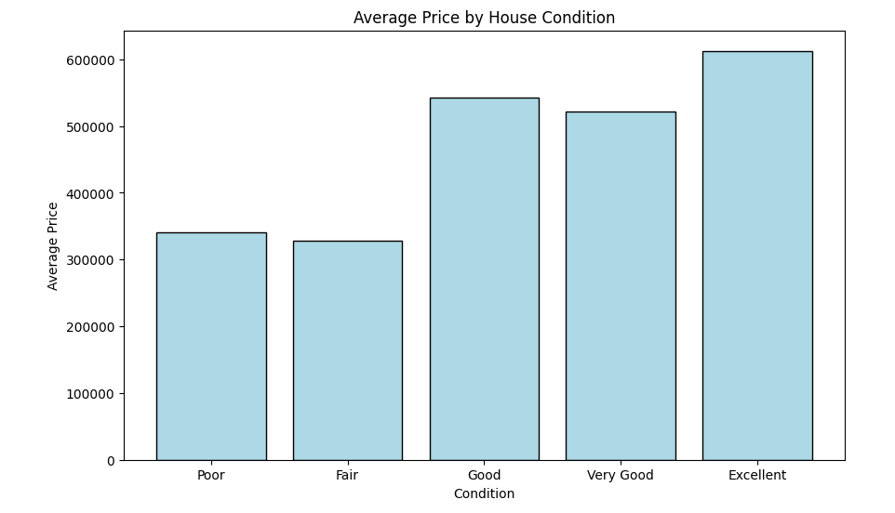
Price by Condition
H2.1 Condition influences Prices

Slide 11
Price by Condition
H2.1 Condition influences Prices

Slide 12
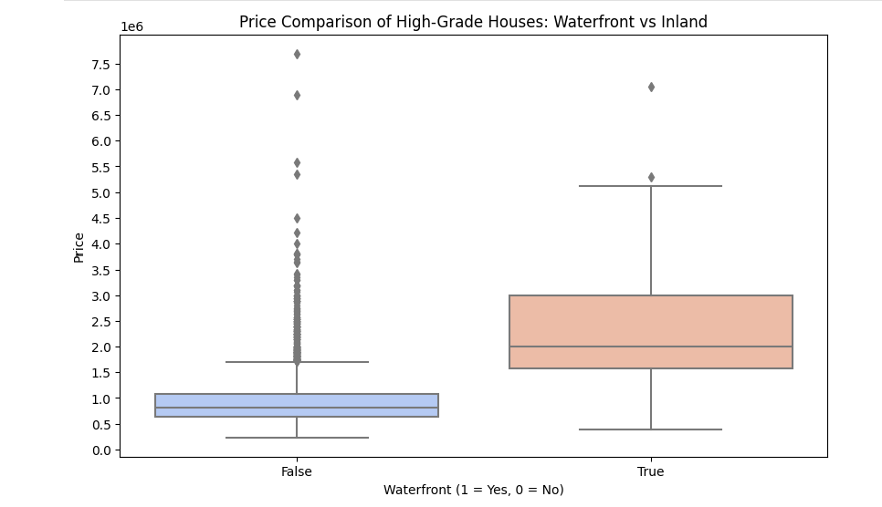

Comparison waterfront and inland
H3: High-grade (>=9) houses located near waterfront are more expensive than the ones inland

Slide 13
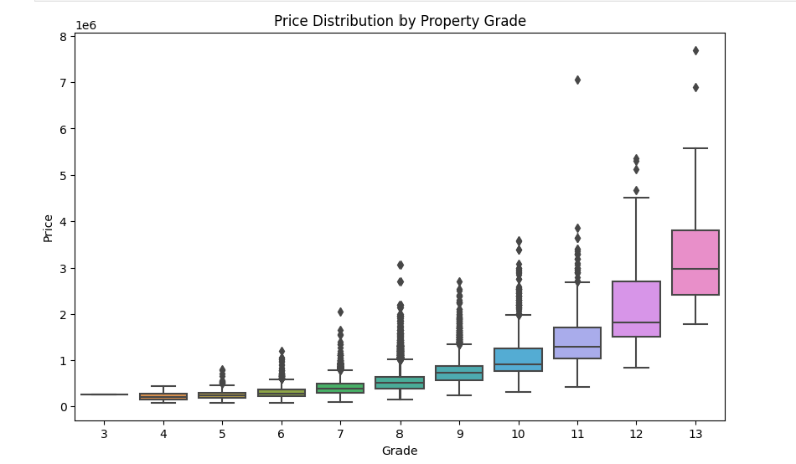
Key insights
Focus on properties with a grade of 9 and higher
Look for high-grade homes with a history of price appreciation

Slide 14
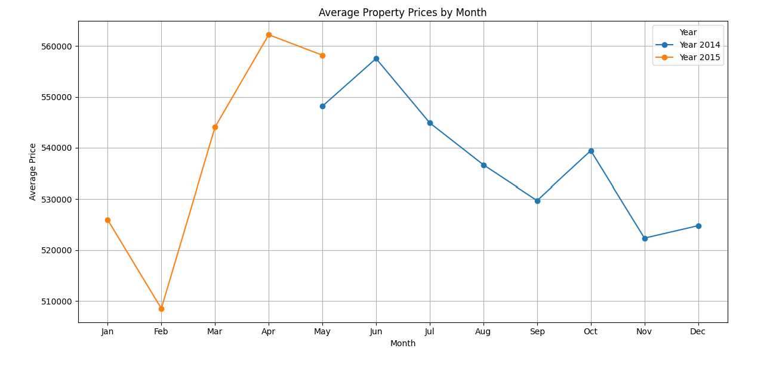
Key insights

Slide 15
Recommendations
Focus on zip codes near waterfront
Consider high-grade properties
Prioritize homes with renovation potential
Invest now to capitalize on rising prices and plan for resale

Slide 16
Next Steps for Your Home Purchase
Schedule property viewings
Discuss financing options
Finalize the purchase offer

